Slide 1
Project Name: Ecommerce Analystics
Presented By:
1. Krishna
2. Govind
3. Khushi
4. Sanket
5. Spandana
6. Shubham
7. Feba Guided by:
1. Anand Babu
2. Varsha

Slide 2
INDEX
Introduction
KPI 1 Weekday Vs Weekend (order_purchase_timestamp) Payment Statistics
KPI 2 Number of Orders with review score 5 and payment type as credit card.
KPI 3 Average number of days taken for order_delivered_customer_date for pet_shop
KPI 4 Average price and payment values from customers of sao paulo city
KPI 5 Relationship between shipping days (order_delivered_customer_date - order_purchase_timestamp) Vs review scores.
Excel Dashboard
Power BI Dashboard
Tableau Dashboard
SQL
Conclusion

Slide 3
INTRODUCTION
Olist is a Brazilian e-commerce marketplace connecting customers and sellers.
The project analyzes approximately 100K orders from 2016–2018.
The dataset includes information about customers, orders, products, sellers, payments, reviews, and delivery.
The different datasets are connected through common keys such as Order ID, Customer ID, Product ID, and Seller ID.The analysis provides insights into sales performance, customer satisfaction, payment methods, and delivery efficiency.

Slide 4
KPI 1 Weekday Vs Weekend (order_purchase_timestamp) Payment Statistics.
Grand Total is 16008872.12
Weekday is 12367988.08
Weekend is 3640884.04

Slide 5
KPI 2 Number of Orders with review score 5 and payment type as credit card.
Sum of ORDER NO OF CREDIT CARDS (5 STARS)
43981

Slide 6
KPI 3 Average number of days taken for order_delivered_customer_date for pet_shop
Pet_ Shop Average delivery is 0940855756872
Grand Total is 12.0940855756872

Slide 7
KPI 4 Average price and payment values from customers of sao paulo city
Average of price 113.0580929
Average of Payment Value is 134.6496837

Slide 8
KPI 5 Relationship between shipping days (order_delivered_customer_date - order_purchase_timestamp) Vs review scores.

Slide 9
KPI 6 Top 10 Categories by Sales Revenue:
garden_tools 485455
Auto 592782
Houseware 632522
cool_stuff 635430
furniture_decor 730074
computers_accessories 912285
sports_leisure 988292
bed_bath_table 1037622
watches_gifts 1205202
health_beauty 1258887
Grand Total 8478551

Slide 10
KPI 7 Which payment method is most frequently used by customers
Grand Total 103886
Boleto 19784
Credit_card 76795
Debit_card 1529
not_defined 3voucher 5775
MOST USED PAYMENT METHOD
Credit Card 76,795 payments (73.92%)

Slide 11
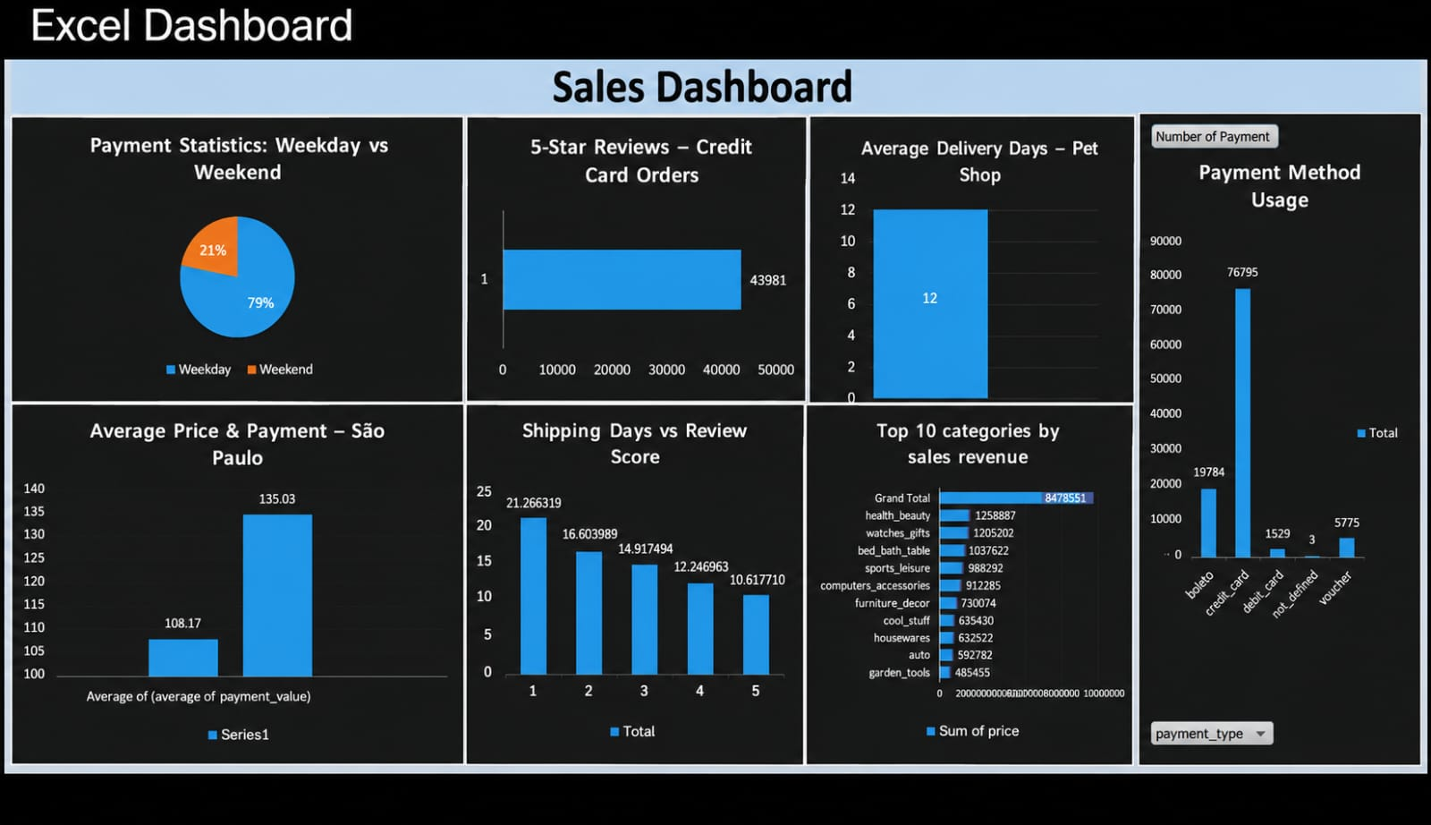
Excel Dashboard

Slide 12
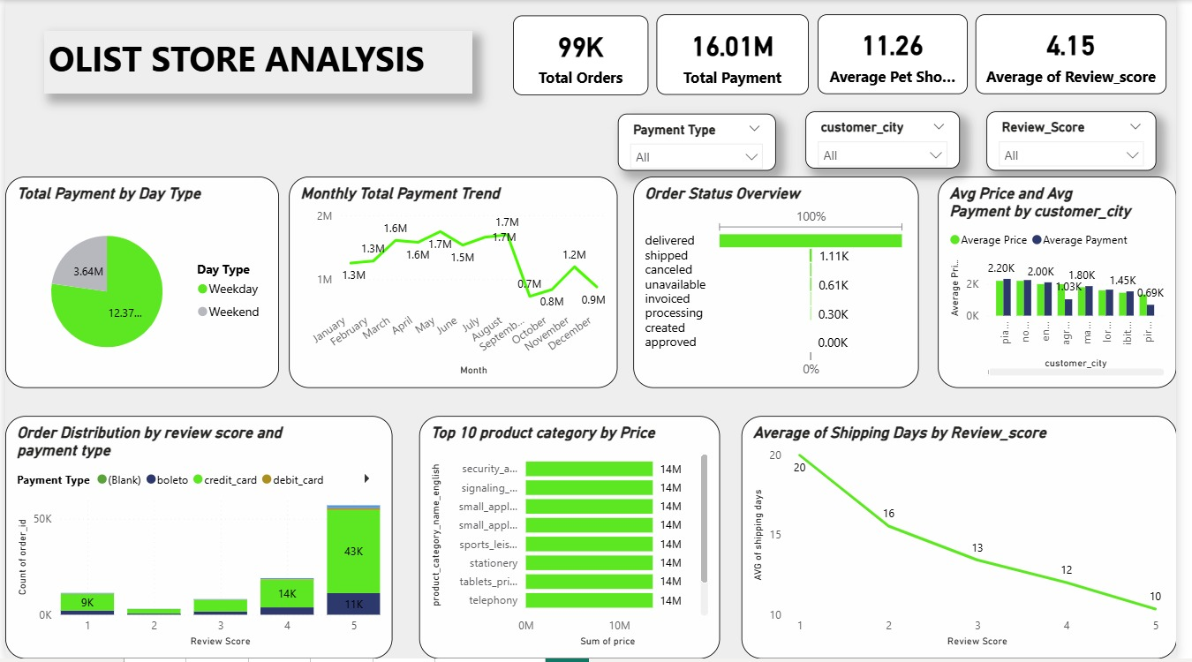
Power BI Dashboard

Slide 13
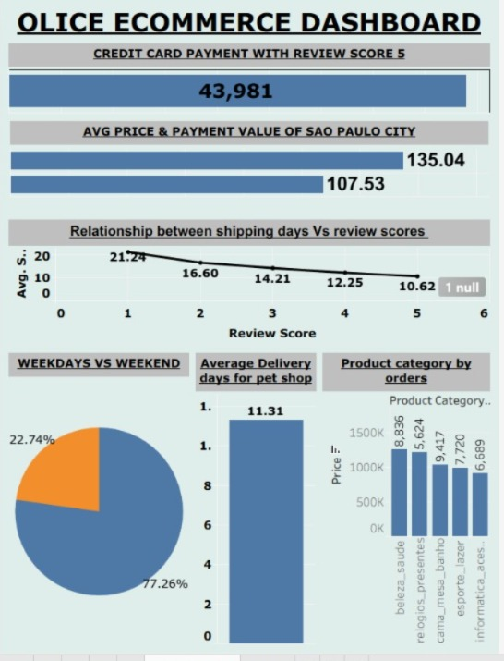
Tableau Dashboard

Slide 14
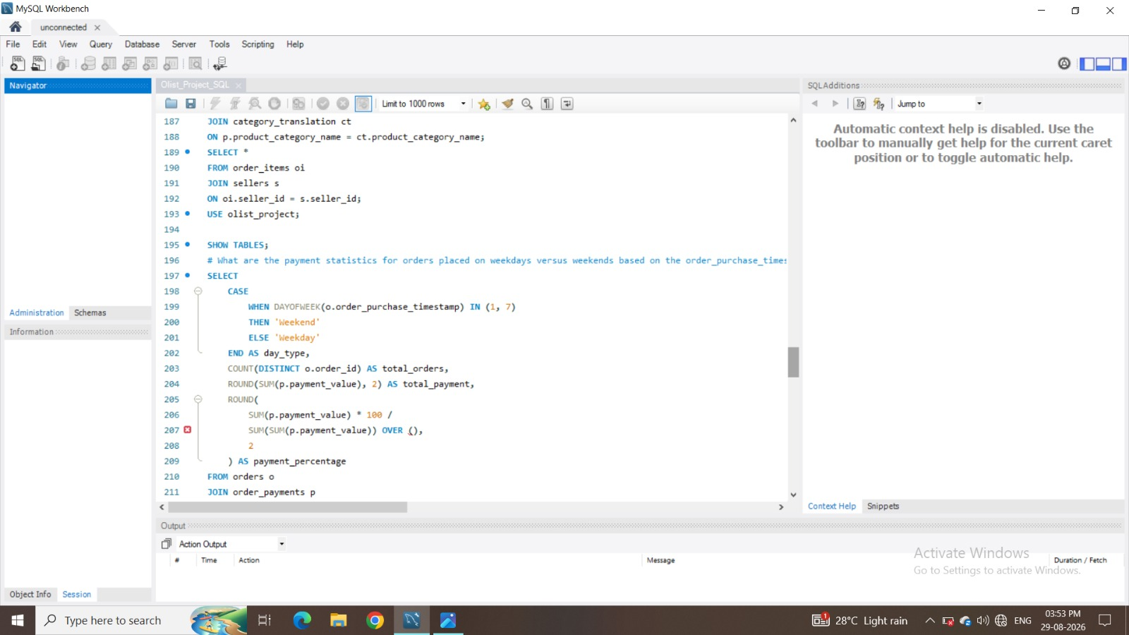
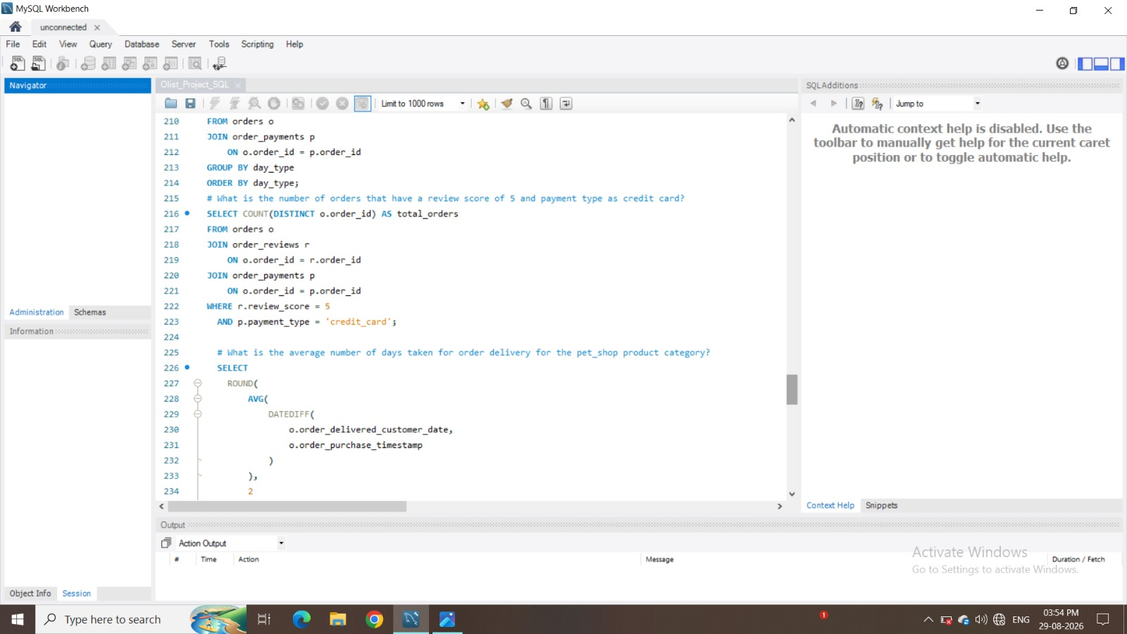
MYSQL

Slide 15
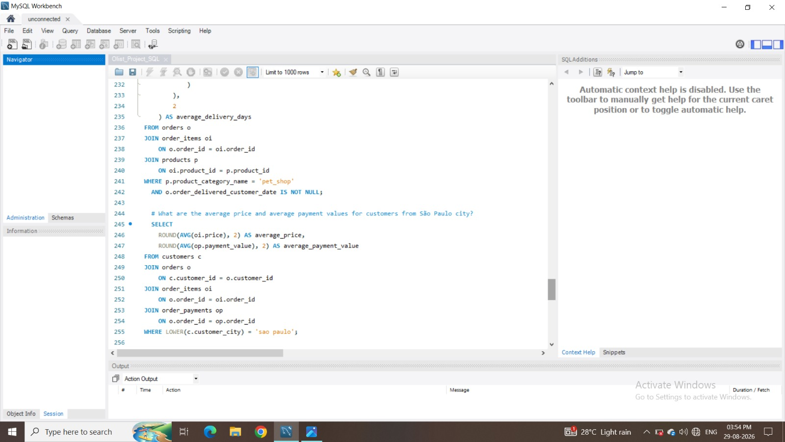
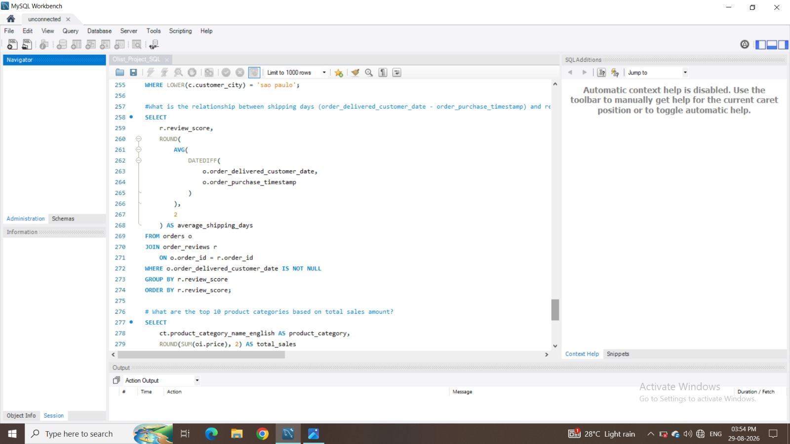

Slide 16
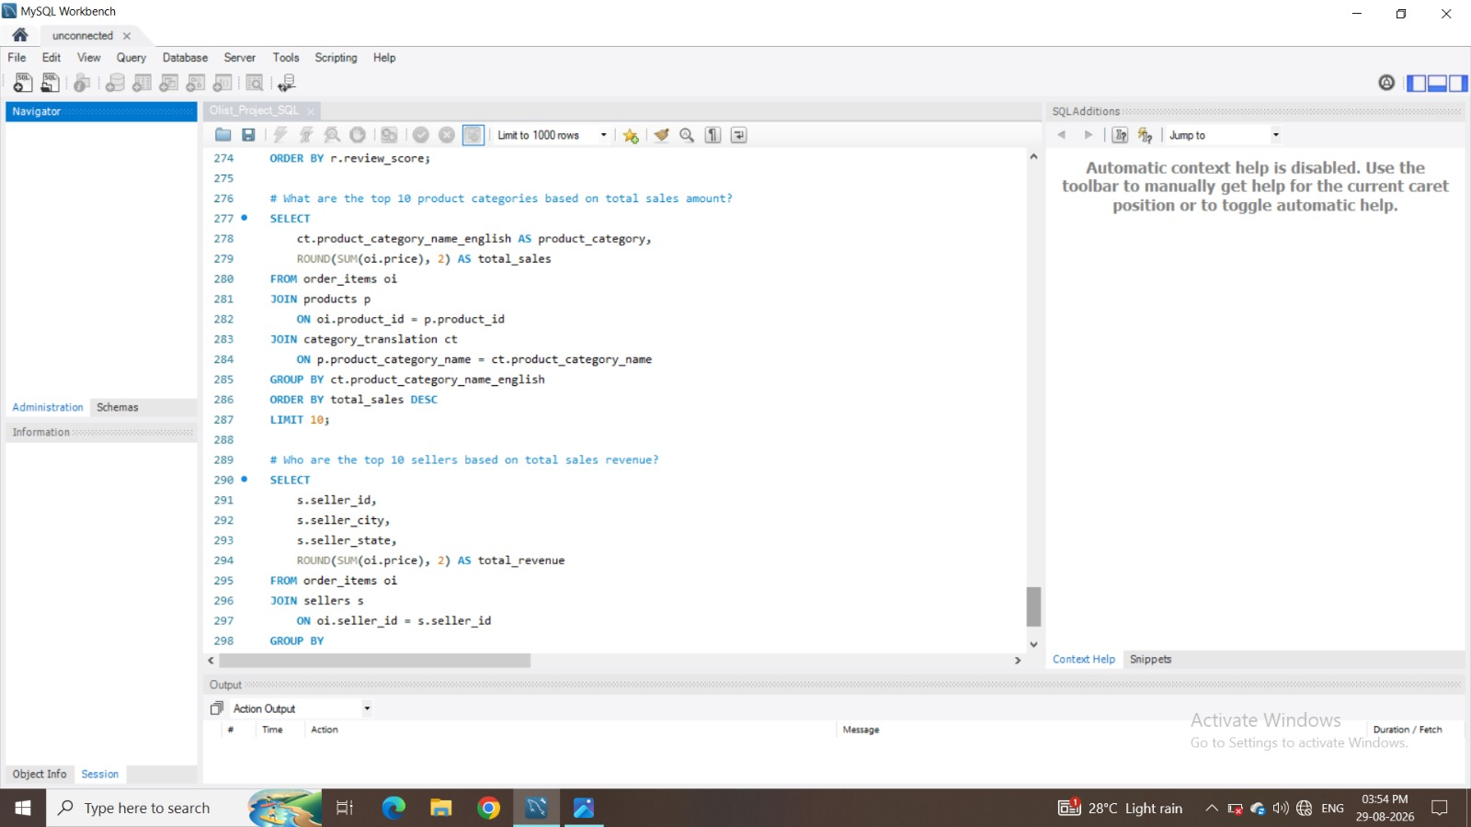
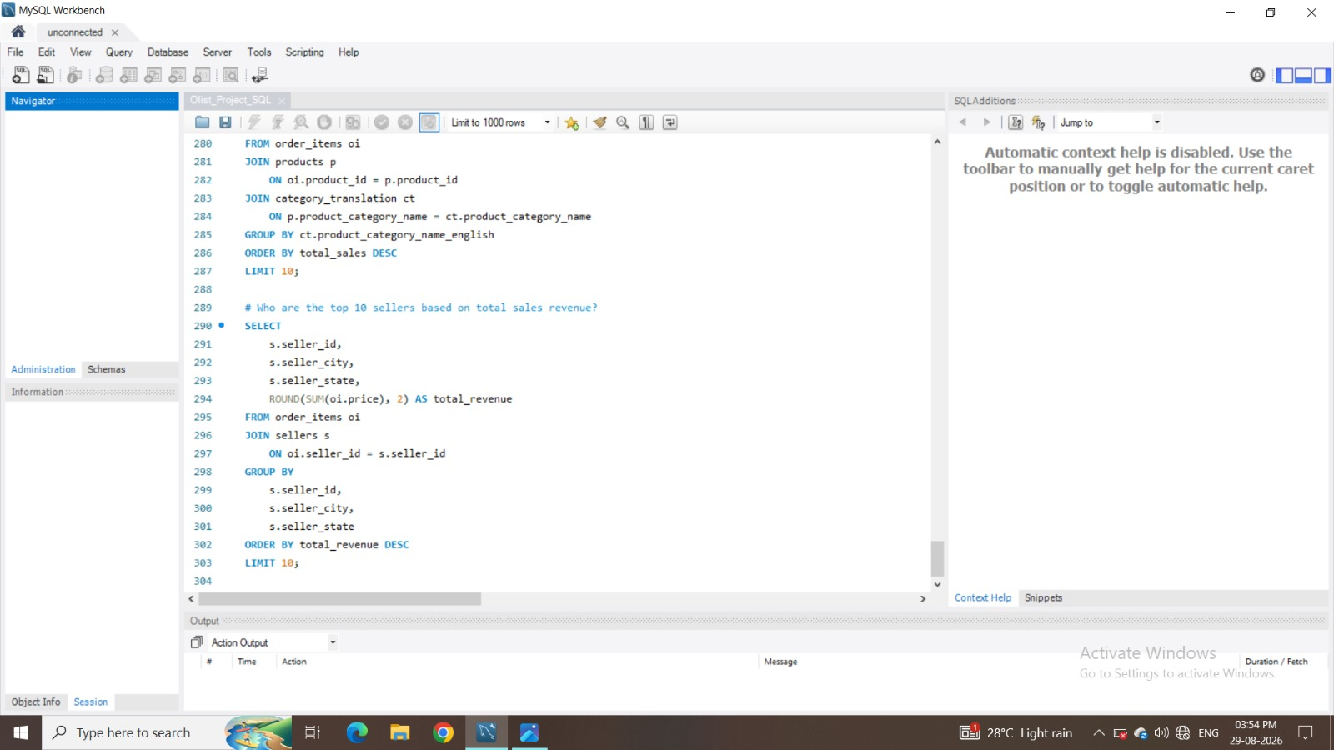

Slide 17
Challenges Faced
A major challenge is that total payment value alone does not explain customer behaviour. It may be affected by the number of orders, discounts, product categories, or seasonal campaigns.
Alternative solution Instead of using only a weekday-versus-weekend comparison, we can use a time-series dashboard showing
Declining Sales in Some Regions – Certain regions are not achieving the expected sales targets.
Low Customer Retention – Difficulty in retaining existing customers and encouraging repeat purchases.Uneven Product Performance – Some products generate high revenue, while others have consistently low sales.
Seasonal Sales Fluctuations – Sales vary significantly during different months or seasons.
Target Achievement Gap – Actual sales are below the planned/target sales in some periods.
High Dependence on Top Products – A small number of products contribute a large portion of total revenue.
Limited Customer Insights – Lack of detailed information about customer preferences and buying behavior.
Profit Margin Pressure – Increasing discounts or costs can reduce overall profitability.
Data Quality & Accuracy – Missing, duplicate, or inconsistent sales data can affect decision-making.

Slide 18
Conclusion
To conclude, this project shows that data analytics can connect sales, payment, delivery, and customer satisfaction into one business view.The key findings are that weekday payments are higher, credit cards are the dominant payment method, health and beauty leads category revenue, and faster delivery is associated with better customer reviews.
The most important business opportunity is improving delivery performance, because shipping time appears to have a strong relationship with customer satisfaction.

